Slide 1
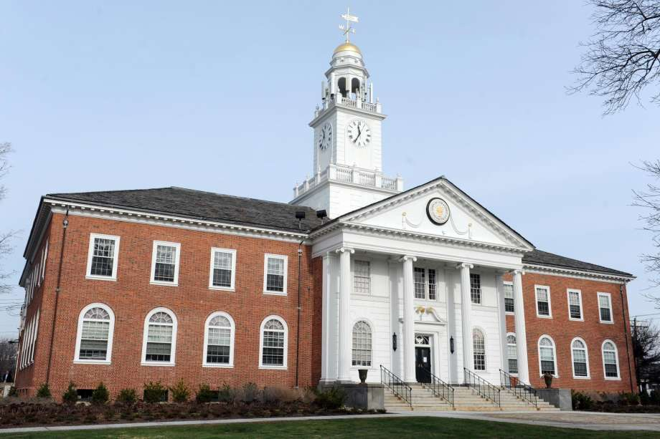
Legal Issues with reopening city and town halls
Pierce Coleman PLLC
Justin S. Pierce
justin@piercecoleman.com
Stephen Coleman
steve@piercecoleman.com
Aaron D. Arnson
aaron@piercecoleman.com

Slide 2
“Opening up America again” plan
Federal guidance on phased reopening of businesses and public spaces.
Phase 1 “Gating” Factors:
Downward trajectory of COVID- and flu-like illness within a 14-day period.
Downward trajectory of documented COVID cases and positive tests as a percentage of total tests within a 14-day period (with a flat or increasing volume of tests).
Area hospitals able to treat all patients without crisis care and have a robust testing program in place for at-risk healthcare workers.
Arizona is in Phase 1 – limited and cautious reopening measures.

Slide 3
legal issues
General liability issues related to reopening
Returning to work and employee safety
Conducting public meetings

Slide 4
Reopening – General Liability Issues
Question: Is the city/town liable if we reopen and someone contracts COVID-19?
Answer: It depends (of course).

Slide 5
Reopening – General Liability Issues
Employees
Workers’ compensation is the exclusive remedy for on-the-job injuries or death of employees, except in cases of employer’s “willful misconduct.”
Willful misconduct means “an act done knowingly and purposely with the direct object of injuring another” – this provision not likely to apply to COVID-19 cases.
Customers/Members of the Public
Greater risk of a negligence or wrongful death claim with these groups.
Government entities have certain immunities, but immunity for any particular act depends on the circumstances.

Slide 6
Reopening – General Liability Issues
Cannot eliminate all risk, but can mitigate risk:
Develop a reopening plan (see League guidance document) that implements most recent CDC and related guidance.
Restrict employees and public – if possible to work from home or conduct activities remotely, do so.
Implement no-contact/physical barriers, including use of PPE.
Consider temperature checks/testing for employees with high interaction with the public.
Participant waivers (with COVID-19/communicable disease language) for special events/facility usage.

Slide 7
Returning to work – Accommodations for at-risk employees
ADA requires reasonable accommodations for employees with disabilities where there is no undue burden on the employer.
In pandemic context, these may include:
Physical separation to the extent possible.
Installation of plastic barriers/sneeze guards.
Provision of an air purifier.
Remote work or telework for a period of time.
Employers should not assume that at-risk employees or employees with a disability need an accommodation, and they cannot impose restrictions on only these employees or exclude these employees from returning to work.
Employers can ask these employees if they anticipate needing an accommodation.

Slide 8
Returning to work – Concerned Employees
What about employees who don’t have a disability but who are afraid to return to work – because the employee cares for an elderly parent, the employee’s spouse is pregnant, etc.?
Recommended steps:
Have a conversation to address specific concerns – avoid escalating.
Implement concrete measures to alleviate employee concerns.
Employee cannot refuse to come to work absent a reasonable belief that there is a threat of death or serious physical harm likely to occur immediately or within a short period (specific fear of infection based in fact and employer cannot reasonably address the specific fear).

Slide 9
Returning to work – Employee testing
ADA prohibits medical examinations and disability-related inquiries of current employees except where “job-related and consistent with business necessity.”
In pandemic, actions that are “job-related and consistent with business necessity” are taken to prevent a “direct threat” to the health of others.

Slide 10
Returning to work – Employee testing
This standard is interpreted broadly during times of pandemic.
Employers may:
Ask employees if they are experiencing symptoms of COVID-19.
Take employees’ temperatures.
Require an employee to leave work or stay home if experiencing symptoms of COVID-19.
Administer or require a COVID-19 test to detect presence of the virus before allowing employee to enter or return to work.

Slide 11
Returning to work – Employee testing
Accurate and reliable tests to detect present infection are allowed.
Tests that detect previous infection (e.g., antibody tests) are likely not allowed.
Again, employee testing is permissible only where employee may pose a “direct threat” to the health of others.
Previous infection probably does not pose a direct threat.
Remember that employee health information must be kept confidential and separate from employee’s personnel file!

Slide 12
Returning to work – Personal protective equipment
An employer may require employees to wear personal protective equipment (PPE), including gloves and masks, and engage in infection control practices, including washing hands.
OSHA General Requirements
Provide and require use of PPE where reasonably necessary.
Train employees on proper use and limitations of PPE.

Slide 13
Returning to work –Accommodations for employees using ppe
ADA/Title VII require employers to provide accommodations where reasonable and would not impose an undue hardship on the business.
Some employees with a disability or religious belief may need a reasonable accommodation to use PPE under the ADA/Title VII.
Non-latex gloves.
Modified face masks (or no masks) for individuals with respiratory difficulties.
Modified PPE due to religious articles of clothing.
Employer should discuss the request and provide the modification or an alternative if reasonable and not impose an undue hardship.

Slide 14
Returning to Work – Managing COVID-19 related Leave
What happens when employees need leave for reasons related to COVID-19?
Several categories of leave potentially available:
Traditional leave under Family Medical Leave Act (FMLA).
Paid sick leave under Arizona paid sick leave law.
PTO/vacation time/other leave accrued under employer policies.
Emergency paid sick leave and emergency FMLA leave under Families First Coronavirus Response Act (FFCRA) – until Dec. 31, 2020.

Slide 15
Reopening facilities to the Public
Most city and town halls are/were closed to the public or had limited public access.
During emergency, mayor has authority to “clos[e] to public access any public building, street, or other public place.”
Resuming public access must balance right to be in public areas with need to limit access to prevent spread.

Slide 16
Reopening facilities to the Public – Meetings
Open Meeting Law (OML) requires that meetings of public body occur openly, with the public able to view meetings.
Although call to the public/public participation is generally not required, some municipal actions (e.g., zoning actions, certain code amendments) require a public hearing at which the public is permitted to speak.
During pandemic, most or all municipalities:
Closed meetings to public, in favor of cable access/online streaming only.
Suspended call to the public and, where possible, delayed public hearing items.
Considered only those agenda items necessary to ensure continued operations and delayed “controversial” items or those likely to draw large crowds.

Slide 17
Reopening facilities to the Public – Meetings
Municipalities are restarting meetings and opening them to the public and will need to take up items that were previously delayed.
Suggestions:
Arrange council chambers to ensure social distancing guidelines can be observed.
Ask councilmembers to participate remotely if possible and require only essential staff to attend.
Continue to encourage public to observe via livestream/cable access.
Consider postponing call to the public until a date certain until you have a sense of how many people will attend meetings, etc.
Limit capacity.

Slide 18
Reopening facilities to the Public – Meetings
Public hearing items – advising the public on what to expect is the key.
Consider the following options:
Encourage written comments online/at the door before the meeting.
Option for comments by phone/Zoom during meeting (experiences with this?)

Slide 19
Questions/Comments?

