Slide 2
The City of Peoria’s
Response to COVID 19
Reopening Town Hall:
Legal Considerations and Best Practices
May 28,2020

Slide 3
Approach
Proactive
Objective
Comprehensive
Internal workforce
Community

Slide 4
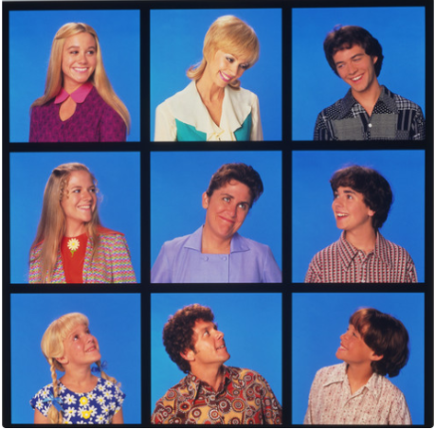
Working Groups
Covid Action Response Team (A.R.T.)
Business Support
Supplemental Services
Public Outreach
Mayor’s Task Force

Slide 5
Declarations
Declaration of Emergency
Federal Funding Eligibility
Greater Flexibility

Slide 6
Policy Considerations
Leave
Exposure Control
Supercleaning
Public Meetings

Slide 7
Other Considerations
PPE protocol
Communication
External
Internal
Cost tracking

Slide 8
Opening Up Peoria Again
Based on White House Plan
Arizona Adopts Same Model

Slide 9
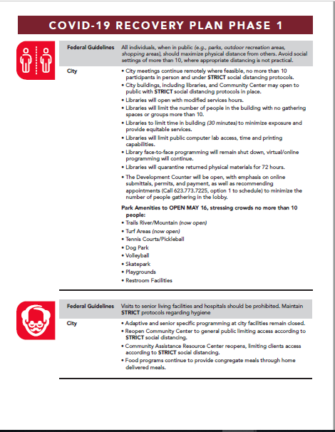
Opening Up Peoria Again
Three phases
Point by Point Fed Guidance/ City Actions
External
Internal
No dates on phases
Federal Gating criteria, State Guidance, Local needs
www.peoriaaz.gov/covid19.

Slide 10
Opening Up Peoria Again
Conference Room Capacity
Wellness Windows/floor decals
Voluntary measures for employees, no public requirements

Slide 11
Final Thoughts
Currently:
Work groups continue to meet
Monitoring, planning for additional triggers
Fiscal Matters considerations
Grants, reimbursements, budget adjustments
Notes:
Last slide

